Slide 1

Review: Rotation Matrix
by Sarot SRANG

Slide 2
Contents
Review of Matrix operation
Direction Cosine
Rotation Matrix in 2D
Rotation Matrix in 3D
Coordinate Transformation
Properties of Rotation Matrix
Time Derivative of Rotation Matrix

Slide 3

Review of Matrix addition
$\left[\begin{matrix}1 & −1 & 2 \\ 1 & 3 & 0\end{matrix}\right]+\left[\begin{matrix}0 & 1 & 1 \\ 1 & −2 & 3\end{matrix}\right]=\left[\begin{matrix}1 & 0 & 3 \\ 2 & 1 & 3\end{matrix}\right]$
$A_{2×3}+B_{2×3}=C_{2×3}$
$\left[\begin{matrix}2 & 0 \\ 1 & −1\end{matrix}\right]+\left[\begin{matrix}0 & 1 & 1 \\ 1 & −2 & 3\end{matrix}\right]$
$A_{2×2}+B_{2×3}$
Dimension must agree!

Slide 4

Review of Matrix multiplication
$\left[\begin{matrix}2 & 0 \\ 1 & −1\end{matrix}\right]\left[\begin{matrix}0 & 1 & 1 \\ 1 & −2 & 3\end{matrix}\right]=\left[\begin{matrix}0 & 2 & 2 \\ & & \end{matrix}\right]$
$\left[\begin{matrix}2 & 0 \\ 1 & −1\end{matrix}\right]\left[\begin{matrix}0 & 1 & 1 \\ 1 & −2 & 3\end{matrix}\right]=\left[\begin{matrix}0 & 2 & 2 \\ −1 & 3 & −2\end{matrix}\right]$
$A_{2×2}B_{2×3}=C_{2×3}$
$A_{2×3}B_{2×3}$
Dimension must agree!

Slide 5
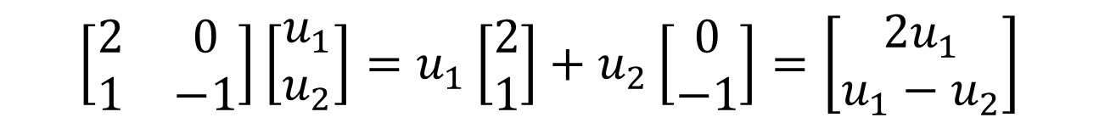
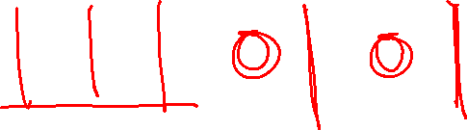
Matrix multiplication with column picture
$$\left[\begin{matrix}2 & 0 \\ 1 & −1\end{matrix}\right]\left[\begin{matrix}u_{1} \\ u_{2}\end{matrix}\right]=u_{1}\left[\begin{matrix}2 \\ 1\end{matrix}\right]+u_{2}\left[\begin{matrix}0 \\ −1\end{matrix}\right]=\left[\begin{aligned}2u_{1} \\ u_{1}−u_{2}\end{aligned}\right]$$

Slide 6




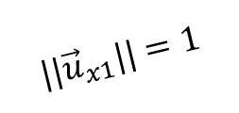



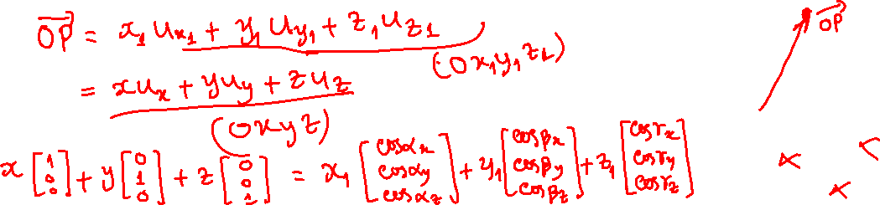





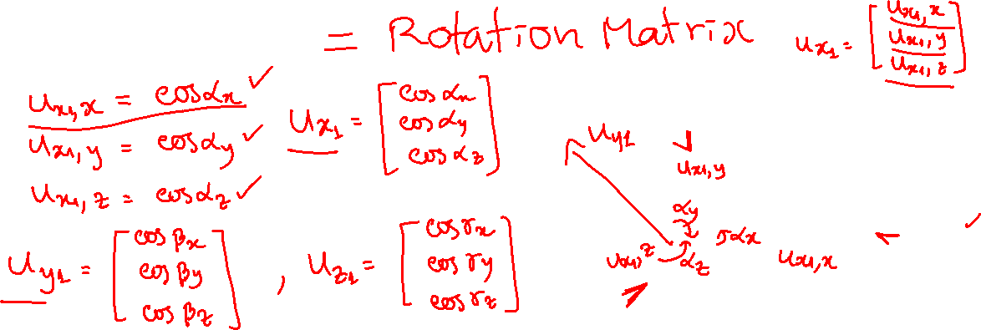





Direction cosine
$$y$$
$${||\vec{u}}_{x1}||=1$$
$$x$$
$$z$$
$$y_{1}$$
$$y$$
$$ψ$$
$${\vec{u}}_{y1}$$
$$x_{1}$$
$${\vec{u}}_{x1}$$
$$ψ$$
$$x$$
$${\vec{u}}_{z1}$$
$$x$$
$$x_{1}$$
$$z, z_{1}$$
$$θ$$

Slide 7
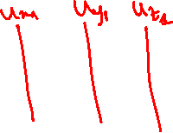
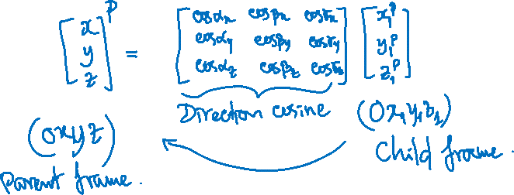

Slide 8















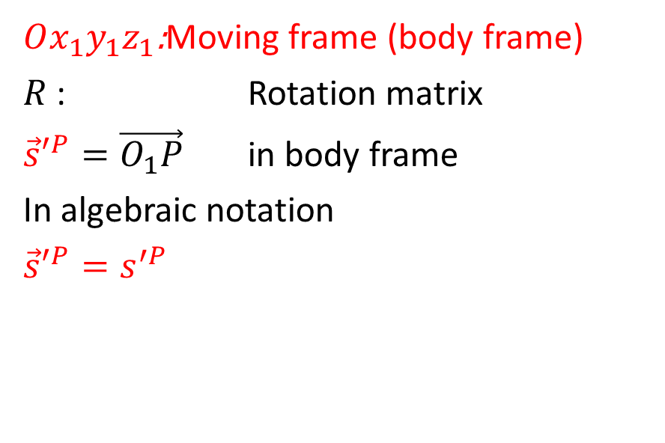



$Oxyz$: Fixed frame (global frame)
$R$ : Rotation matrix
${\vec{r}}^{P}=\vec{OP}$ in fixed frame
${\vec{s}}^{P}=\vec{O_{1}P}$ in fixed frame
In algebraic notation
${\vec{r}}^{P}=r^{P}$
${\vec{s}}^{P}=s^{P}$
$Ox_{1}y_{1}z_{1}$:Moving frame (body frame)
$R$ : Rotation matrix
${\vec{s}′}^{P}=\vec{O_{1}P}$ in body frame
In algebraic notation
${\vec{s}′}^{P}=s^{′P}$
$$z$$
$$z_{1}$$
$$R$$
$$P$$
$$y_{1}$$
$$z$$
$$O_{1}$$
$$y$$
$$r^{P}$$
$$x_{1}$$
$$r$$
$$x$$
$$y$$
$$O$$
$$s^{P}=Rs^{′P}$$
$$r^{P}=r+Rs^{′P}$$
$$x$$

Slide 9

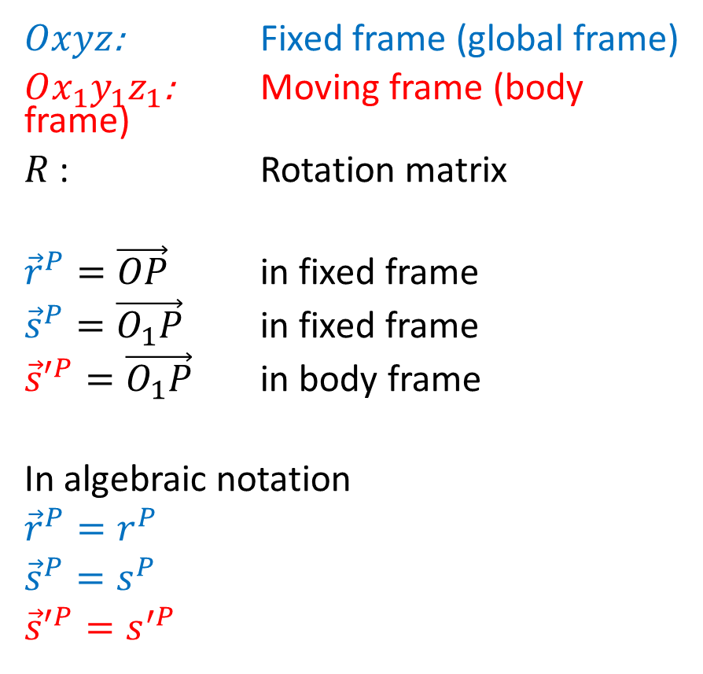


Coordinate Transformation (reasoning in Space)
$$z$$
$$R$$
$$z_{1}$$
$Oxyz$: Fixed frame (global frame)
$Ox_{1}y_{1}z_{1}$: Moving frame (body frame)
$R$ : Rotation matrix
${\vec{r}}^{P}=\vec{OP}$ in fixed frame
${\vec{s}}^{P}=\vec{O_{1}P}$ in fixed frame
${\vec{s}′}^{P}=\vec{O_{1}P}$ in body frame
In algebraic notation
${\vec{r}}^{P}=r^{P}$
${\vec{s}}^{P}=s^{P}$
${\vec{s}′}^{P}=s^{′P}$
$$P$$
$$y_{1}$$
$$z$$
$$O_{1}$$
$$y$$
$$r^{P}$$
$$x_{1}$$
$$s^{′P}$$
$$r$$
$$x$$
$$y$$
$$O$$
$$x$$
$$s^{P}=Rs^{′P}$$
$$r^{P}=r+Rs^{′P}$$

Slide 10
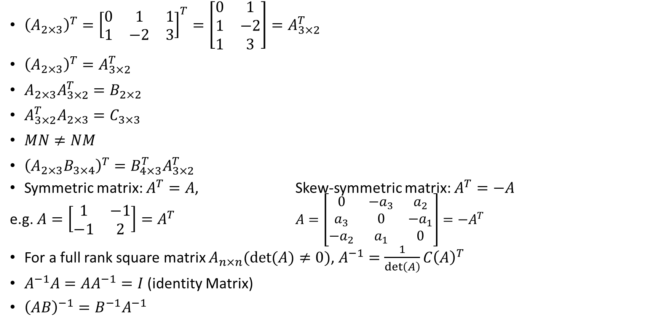
Review of Linear Algebra
${{\left(A_{2×3}\right)}^{T}=\left[\begin{matrix}0 & 1 & 1 \\ 1 & −2 & 3\end{matrix}\right]}^{T}=\left[\begin{matrix}0 & 1 \\ 1 & −2 \\ 1 & 3\end{matrix}\right]=A_{3×2}^{T}$
${\left(A_{2×3}\right)}^{T}=A_{3×2}^{T}$
$A_{2×3}A_{3×2}^{T}=B_{2×2}$
$A_{3×2}^{T}A_{2×3}=C_{3×3}$
$MN≠NM$
${\left(A_{2×3}B_{3×4}\right)}^{T}=B_{4×3}^{T}A_{3×2}^{T}$
Symmetric matrix: $A^{T}=A$, Skew-symmetric matrix: $A^{T}=−A$
e.g. $A=\left[\begin{matrix}1 & −1 \\ −1 & 2\end{matrix}\right]=A^{T}$ $A=\left[\begin{matrix}0 & −a_{3} & a_{2} \\ a_{3} & 0 & −a_{1} \\ −a_{2} & a_{1} & 0\end{matrix}\right]=−A^{T}$
For a full rank square matrix $A_{n×n}(\det{(A)≠0)}$, $A^{−1}=\frac{1}{\det\left(A\right)}C{\left(A\right)}^{T}$
$A^{−1}A=AA^{−1}=I$ (identity Matrix)
${\left(AB\right)}^{−1}=B^{−1}A^{−1}$

Slide 11



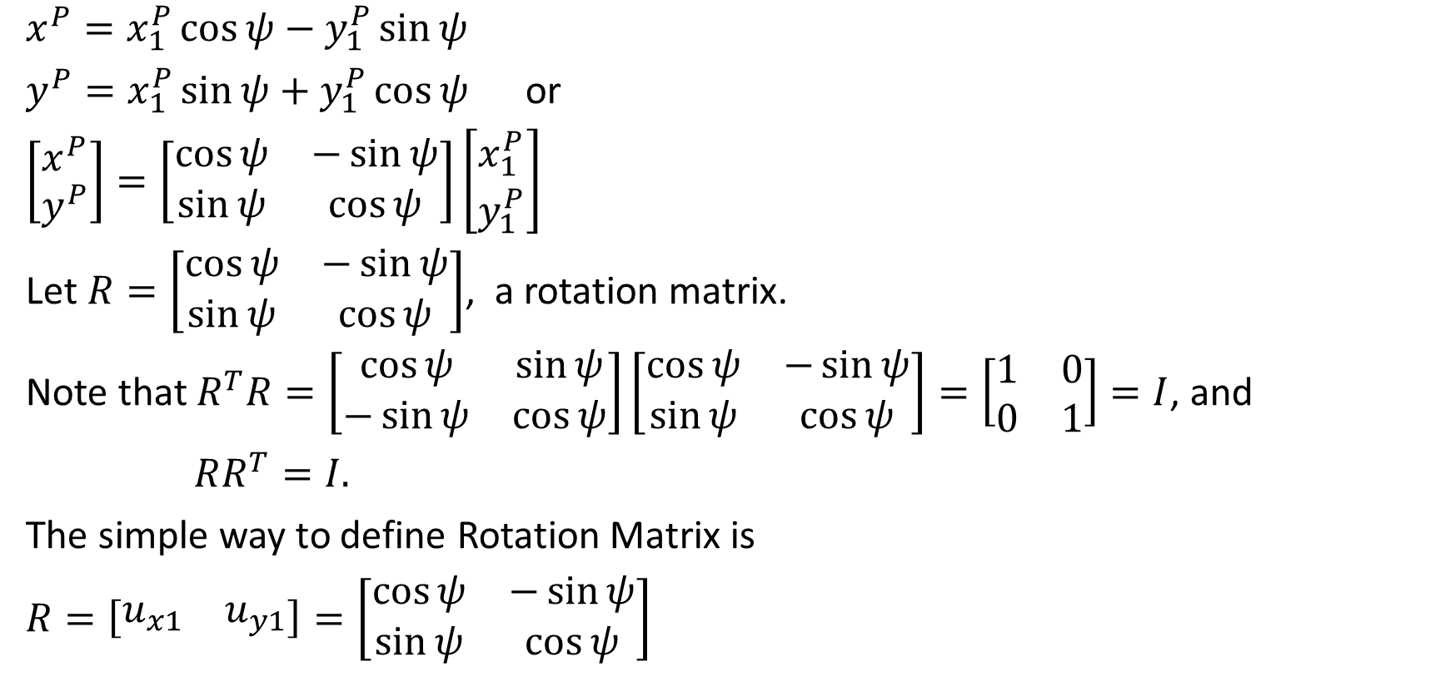




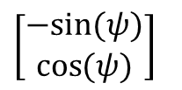




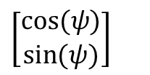









Rotation Matrix in 2D
$$y$$
$x^{P}=x_{1}^{P}\cos{ψ}−y_{1}^{P}\sin{ψ}$
$y^{P}=x_{1}^{P}\sin{ψ}+y_{1}^{P}\cos{ψ}$ or
$\left[\begin{matrix}x^{P} \\ y^{P}\end{matrix}\right]=\left[\begin{matrix}\cos{ψ} & −\sin{ψ} \\ \sin{ψ} & \cos{ψ}\end{matrix}\right]\left[\begin{matrix}x_{1}^{P} \\ y_{1}^{P}\end{matrix}\right]$
Let $R=\left[\begin{matrix}\cos{ψ} & −\sin{ψ} \\ \sin{ψ} & \cos{ψ}\end{matrix}\right]$, a rotation matrix.
Note that $R^{T}R=\left[\begin{matrix}\cos{ψ} & \sin{ψ} \\ −\sin{ψ} & \cos{ψ}\end{matrix}\right]\left[\begin{matrix}\cos{ψ} & −\sin{ψ} \\ \sin{ψ} & \cos{ψ}\end{matrix}\right]=\left[\begin{matrix}1 & 0 \\ 0 & 1\end{matrix}\right]=I$, and
$RR^{T}=I.$
The simple way to define Rotation Matrix is
$R=\left[\begin{matrix}u_{x1} & u_{y1}\end{matrix}\right]=\left[\begin{matrix}\cos{ψ} & −\sin{ψ} \\ \sin{ψ} & \cos{ψ}\end{matrix}\right]$
$$y_{1}$$
$$y^{P}$$
$$P$$
$$y_{1}^{P}$$
$$x_{1}$$
$$ψ$$
$$ψ$$
$$x_{1}^{P}$$
$$ψ$$
$$x$$
$$x^{P}$$
$$y_{1}$$
$$y$$
$\left[\begin{aligned}−sin{(ψ)} \\ \cos{(ψ)}\end{aligned}\right]$
$$ψ$$
$\left[\begin{aligned}\cos{(ψ)} \\ \sin{(ψ)}\end{aligned}\right]$
$$x_{1}$$
$${\vec{u}}_{y1}$$
$${\vec{u}}_{x1}$$
$$ψ$$
$$x$$

Slide 12

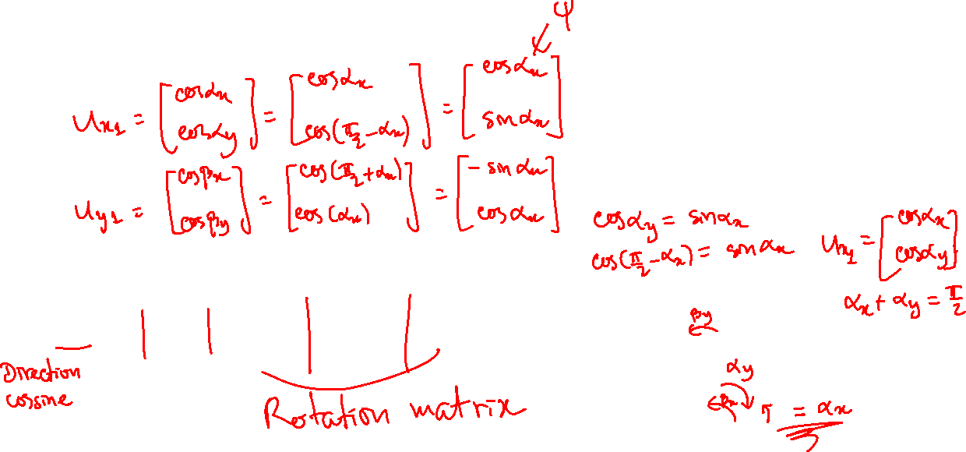
Rotation Matrix in 2D
$$y$$
The simple way to define Rotation Matrix is
$R=\left[\begin{matrix}u_{x1} & u_{y1}\end{matrix}\right]=\left[\begin{matrix}\cos{ψ} & −\sin{ψ} \\ \sin{ψ} & \cos{ψ}\end{matrix}\right]$
$$y_{1}$$
$$y^{P}$$
$$P$$
$$y_{1}^{P}$$
$$x_{1}$$
$$ψ$$
$$ψ$$
$$x_{1}^{P}$$
$$ψ$$
$$x$$
$$x^{P}$$
$$y_{1}$$
$$y$$
$\left[\begin{aligned}−sin{(ψ)} \\ \cos{(ψ)}\end{aligned}\right]$
$$ψ$$
$\left[\begin{aligned}\cos{(ψ)} \\ \sin{(ψ)}\end{aligned}\right]$
$$x_{1}$$
$${\vec{u}}_{y1}$$
$${\vec{u}}_{x1}$$
$$ψ$$
$$x$$

Slide 13






























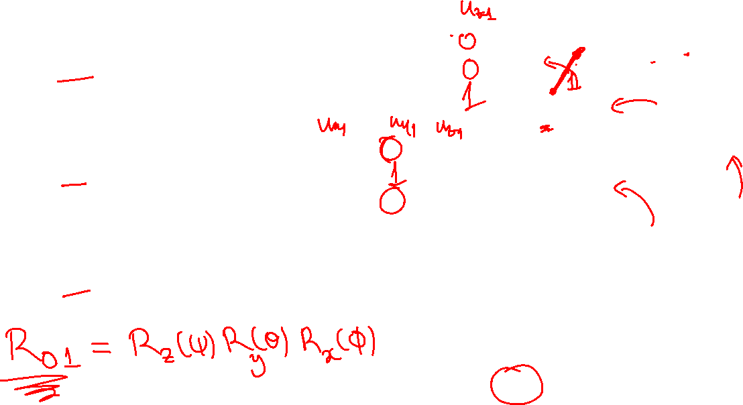

Rotation Matrix in 3D
$$y_{1}$$
$$y$$
$$ψ$$
$${\vec{u}}_{y1}$$
$$x_{1}$$
$${\vec{u}}_{x1}$$
$$x$$
$R_{z}\left(ψ\right)=\left[\begin{matrix}u_{x1} & u_{y1} & u_{z1}\end{matrix}\right]=\left[\begin{matrix}\cos{ψ} & −\sin{ψ} & 0 \\ \sin{ψ} & \cos{ψ} & 0 \\ 0 & 0 & 1\end{matrix}\right]$
$R_{y}\left(θ\right)=\left[\begin{matrix}u_{x1} & u_{y1} & u_{z1}\end{matrix}\right]=\left[\begin{matrix}\cos{θ} & 0 & \sin{θ} \\ 0 & 1 & 0 \\ −\sin{θ} & 0 & \cos{θ}\end{matrix}\right]$
$R_{x}\left(φ\right)=\left[\begin{matrix}u_{x1} & u_{y1} & u_{z1}\end{matrix}\right]=\left[\begin{matrix}1 & 0 & 0 \\ 0 & \cos{φ} & −\sin{φ} \\ 0 & \sin{φ} & \cos{φ}\end{matrix}\right]$
$$ψ$$
$${\vec{u}}_{z1}$$
$$x$$
$$x_{1}$$
$$z, z_{1}$$
$$θ$$
$${\vec{u}}_{x1}$$
$$z_{1}$$
$${\vec{u}}_{z1}$$
$$θ$$
$$z$$
$$z$$
$${\vec{u}}_{y1}$$
$$z_{1}$$
$$θ$$
$$y, y_{1}$$
$${\vec{u}}_{z1}$$
$$y_{1}$$
$${\vec{u}}_{y1}$$
$$φ$$
$$y$$
$${\vec{u}}_{x1}$$
They are Orthonormal matrices!!!
$$x, x_{1}$$

Slide 14


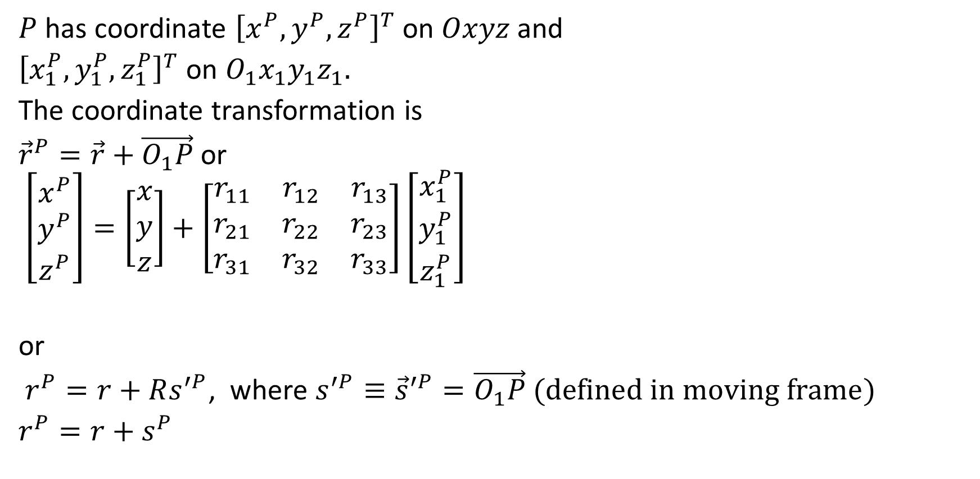


Coordinate Transformation
$$z$$
$$R$$
$$z_{1}$$
$P$ has coordinate ${\left[x^{P},y^{P},z^{P}\right]}^{T}$ on $Oxyz$ and
${\left[x_{1}^{P},y_{1}^{P},z_{1}^{P}\right]}^{T}$ on $O_{1}x_{1}y_{1}z_{1}.$
The coordinate transformation is
${\vec{r}}^{P}=\vec{r}+\vec{O_{1}P}$ or
$\left[\begin{matrix}x^{P} \\ y^{P} \\ z^{P}\end{matrix}\right]=\left[\begin{matrix}x \\ y \\ z\end{matrix}\right]+\left[\begin{matrix}r_{11} & r_{12} & r_{13} \\ r_{21} & r_{22} & r_{23} \\ r_{31} & r_{32} & r_{33}\end{matrix}\right]\left[\begin{matrix}x_{1}^{P} \\ y_{1}^{P} \\ z_{1}^{P}\end{matrix}\right]$
or
$r^{P}=r+Rs^{′P}$, where $s^{′P}≡{\vec{s}}^{′P}=\vec{O_{1}P} (defined in moving frame)$
$r^{P}=r+s^{P}$
$$P$$
$$y_{1}$$
$$z$$
$$O_{1}$$
$$y$$
$$r^{P}$$
$$x_{1}$$
$$r$$
$$x$$
$$y$$
$$O$$
$$R$$
$$x$$
Translation
Rotation

Slide 15

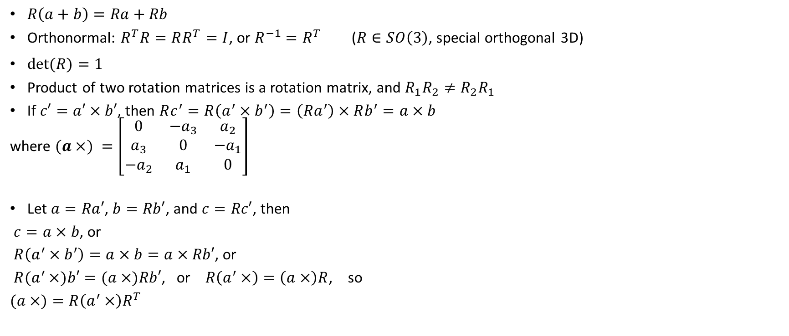







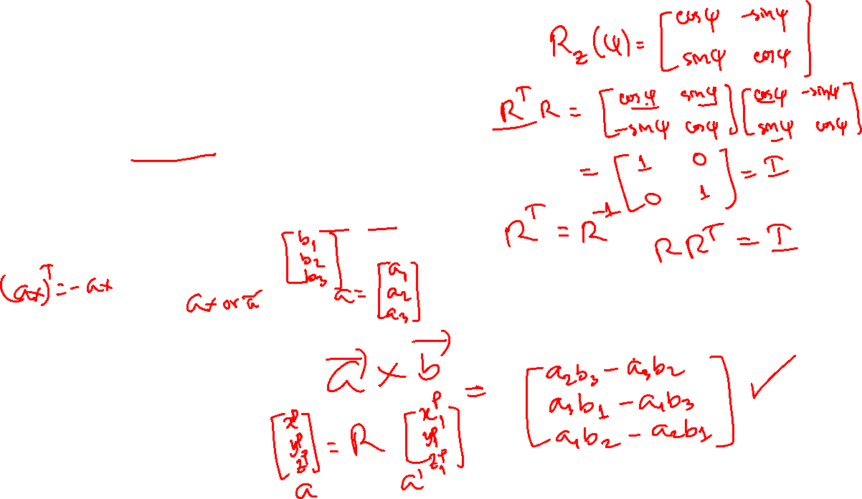
Property of Rotation Matrix
$R\left(a+b\right)=Ra+Rb$
Orthonormal: $R^{T}R=RR^{T}=I$, or $R^{−1}=R^{T}$ ($R∈SO\left(3\right)$, special orthogonal 3D)
$\det{(R)}=1$
Product of two rotation matrices is a rotation matrix, and $R_{1}R_{2}≠R_{2}R_{1}$
If $c′=a′×b′$, then $Rc^{′}=R\left(a^{′}×b^{′}\right)=\left(Ra^{′}\right)×Rb^{′}=a×b$
where $(a×) =\left[\begin{matrix}0 & −a_{3} & a_{2} \\ a_{3} & 0 & −a_{1} \\ −a_{2} & a_{1} & 0\end{matrix}\right]$
Let $a=Ra′$, $b=Rb′$, and $c=Rc′$, then
$c=a×b$, or
$R\left(a^{′}×b^{′}\right)=a×b=a×Rb′$, or
$R(a^{′}×)b′=(a×)Rb′$, or $R\left(a^{′}×\right)=\left(a×\right)R$, so
$(a×)=R\left(a^{′}×\right)R^{T}$
$$b=Rb′$$
$$b′$$
$$a′$$
$$a=Ra′$$
$$R$$
$$c′$$
$$c=Rc′$$

Slide 16
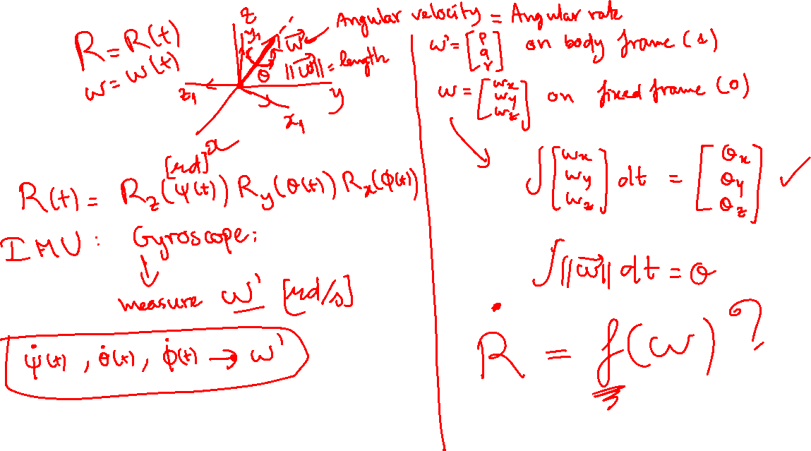

Slide 17
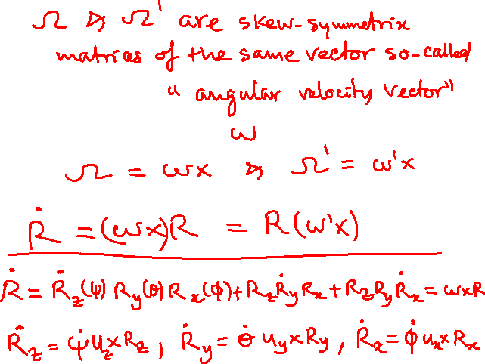
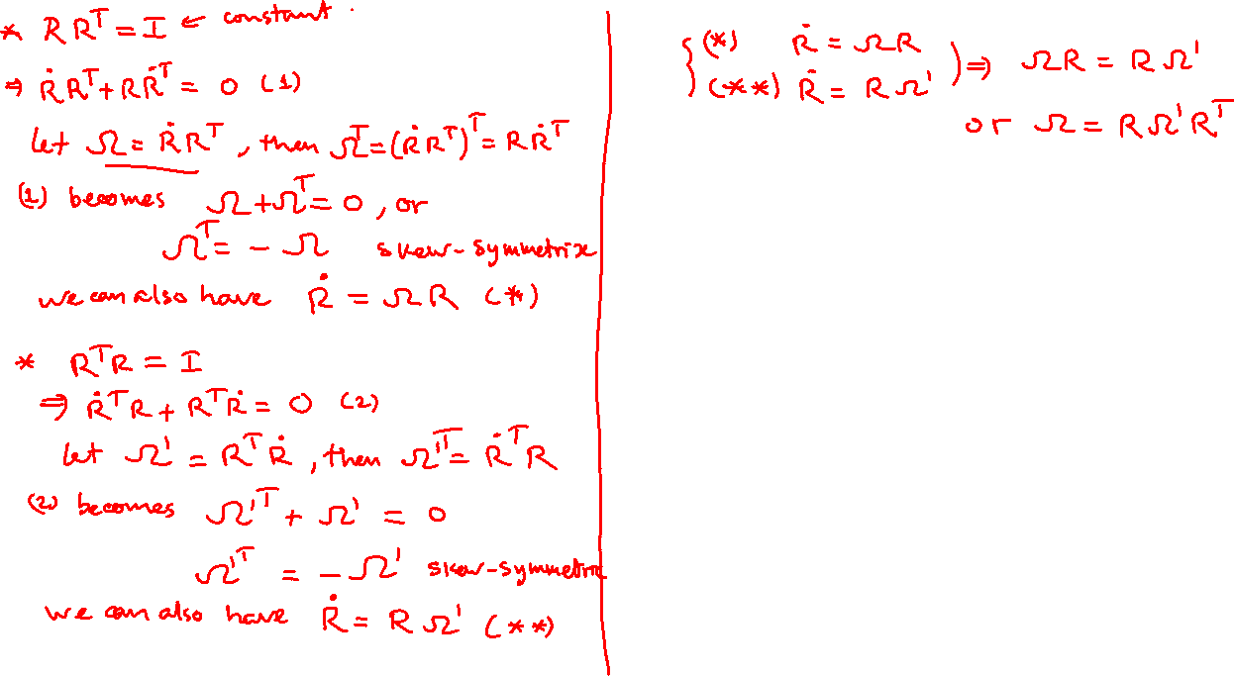

Slide 18

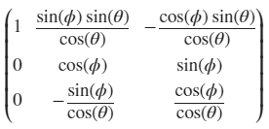

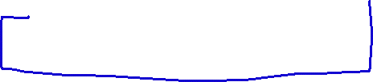





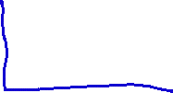


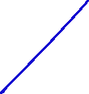





Slide 19

Exercise: Animation of 3D object using rotation matrix

Slide 20
z
y
x

Slide 21














$$z_{1}$$
$$z_{0}$$
Successive rotations
At initial time: all the 3 frames are coincident
Rotation w.r.t fixed frame
First rotate the brown wheel w.r.t y-axis: $R_{12}(θ_{y})$
Then rotate the grey rod w.r.t z-axis: $R_{01}\left(ψ_{z}\right)R_{12}(θ_{y})$
Rotation w.r.t moving frame
First rotate the grey rod w.r.t z-axis (z = z₁): $R_{01}\left(ψ_{z}\right)$
Then rotate the brown wheel w.r.t $y_{1}$-axis: $R_{01}\left(ψ_{z}\right)R_{12}(θ_{y})$
Therefore, $R_{02}\left(ψ_{z},θ_{y}\right)=R_{01}\left(ψ_{z}\right)R_{12}(θ_{y})$
$$z_{2}$$
z
y
$$ψ$$
0
1
$$θ$$
2
$$y_{1}$$
$$y_{2}$$
$$R_{01}(ψ_{z})$$
$$R_{12}(θ_{y})$$
Fixed frame
Moving frame 1
Moving frame 2
$$x_{2}$$
$$y_{0}$$
$$x_{0}$$
$$x_{1}$$
left multiplication
right multiplication

Slide 22
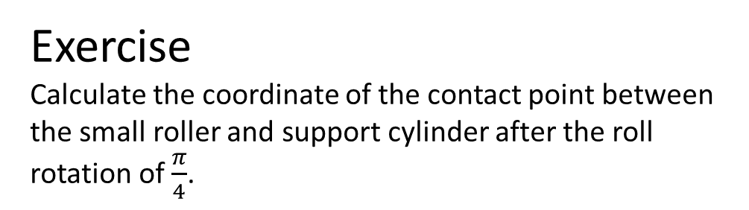
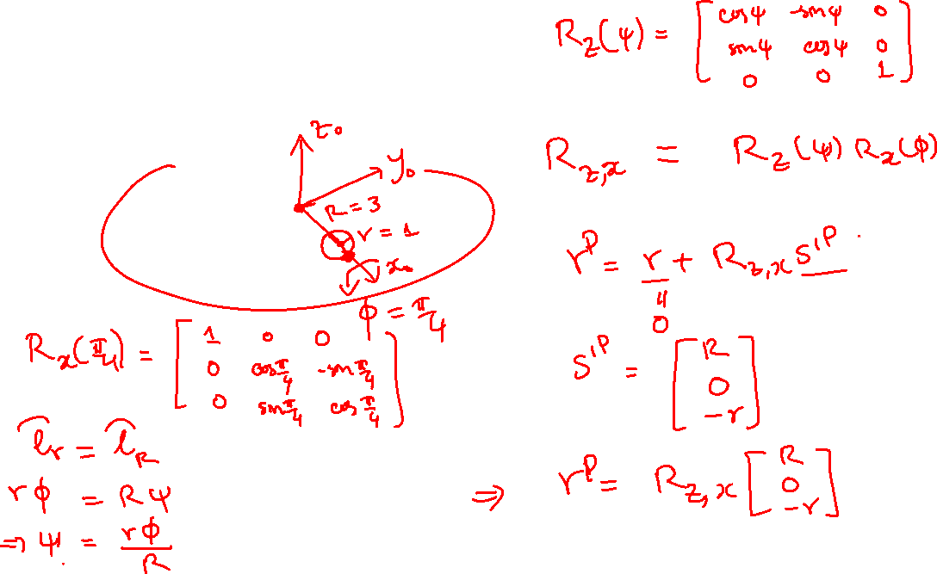
Exercise
Calculate the coordinate of the contact point between the small roller and support cylinder after the roll rotation of $\frac{π}{4}$.

Slide 23
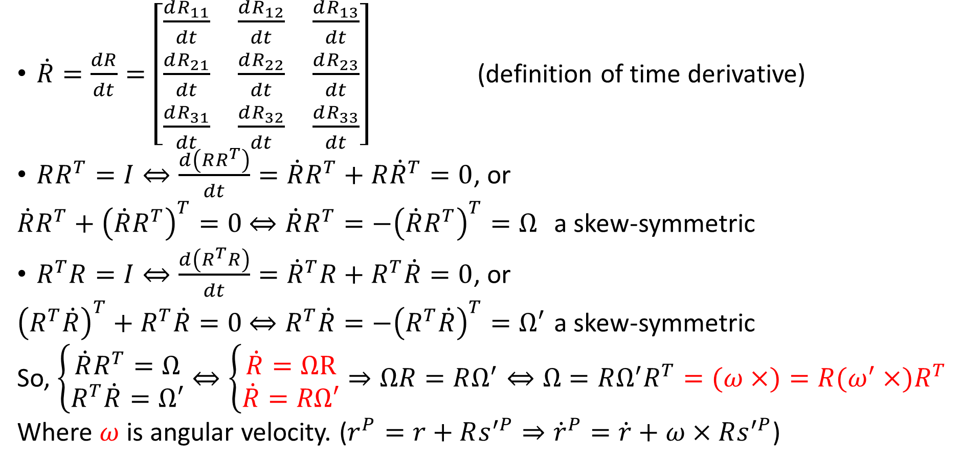
Time Derivative of Rotation Matrix
$\dot{R}=\frac{dR}{dt}=\left[\begin{matrix}\frac{dR_{11}}{dt} & \frac{dR_{12}}{dt} & \frac{dR_{13}}{dt} \\ \frac{dR_{21}}{dt} & \frac{dR_{22}}{dt} & \frac{dR_{23}}{dt} \\ \frac{dR_{31}}{dt} & \frac{dR_{32}}{dt} & \frac{dR_{33}}{dt}\end{matrix}\right]$ (definition of time derivative)
$RR^{T}=I⇔\frac{d\left(RR^{T}\right)}{dt}=\dot{R}R^{T}+R{\dot{R}}^{T}=0$, or
$\dot{R}R^{T}+{\left(\dot{R}R^{T}\right)}^{T}=0$ $⇔\dot{R}R^{T}=−{\left(\dot{R}R^{T}\right)}^{T}=Ω$ a skew-symmetric
$R^{T}R=I⇔\frac{d\left(R^{T}R\right)}{dt}={\dot{R}}^{T}R+R^{T}\dot{R}=0$, or
${\left(R^{T}\dot{R}\right)}^{T}+R^{T}\dot{R}=0$ $⇔R^{T}\dot{R}=−{\left(R^{T}\dot{R}\right)}^{T}=Ω′$ a skew-symmetric
So, $\left\{\begin{aligned}\dot{R}R^{T}=Ω \\ R^{T}\dot{R}=Ω′\end{aligned}\right.⇔\left\{\begin{aligned}\dot{R}=ΩR \\ \dot{R}=RΩ′\end{aligned}\right.⇒ΩR=RΩ^{′}⇔Ω=RΩ^{′}R^{T}=(ω×)=R(ω^{′}×)R^{T}$
Where $ω$ is angular velocity. ($r^{P}=r+Rs^{′P}⇒{\dot{r}}^{P}=\dot{r}+ω×Rs^{′P}$)

